Slide 1


SMART INDIA HACKATHON 2026
TITLE PAGE
Problem Statement ID – SIH26150
Problem Statement Title – Development of a Multi.Vendor DVR/NVR Forensic Analysis Tool to Standardized Acquisition,Recovery, and Analysis of Surveillance Evidence.
Theme- Blockchain & Cyber security
PS Category- Software
Team ID- 192057
Team Name – Code-Sentinels.

Slide 2

Multi-Vendor DVR/NVR Forensic Tool
Proposed Solution
  Secure Acquisition : Read-only disk imaging with SHA-256 hashing.
  Vendor Detection : Auto-identify Hikvision, Dahua, CP Plus and more.
  Video Recovery : Vendor-agnostic H.264 carving, incl. deleted footage.
  Timeline Rebuild : Camera, channel and time-ordered evidence view.
  Tamper Detection : Timestamp gaps, GOP breaks, re-encode signs.
  Integrity Check : ffprobe / FFmpeg frame-level validation of clips.
  Chain of Custody : Hash-chained, append-only log of every action.
  Court-Ready Report : PDF with hash log and BSA 2023 Sec. 63 support.
  Unified Workflow : One tool for police, cyber cells and forensic labs.
@SIH Idea submission
2

Slide 3
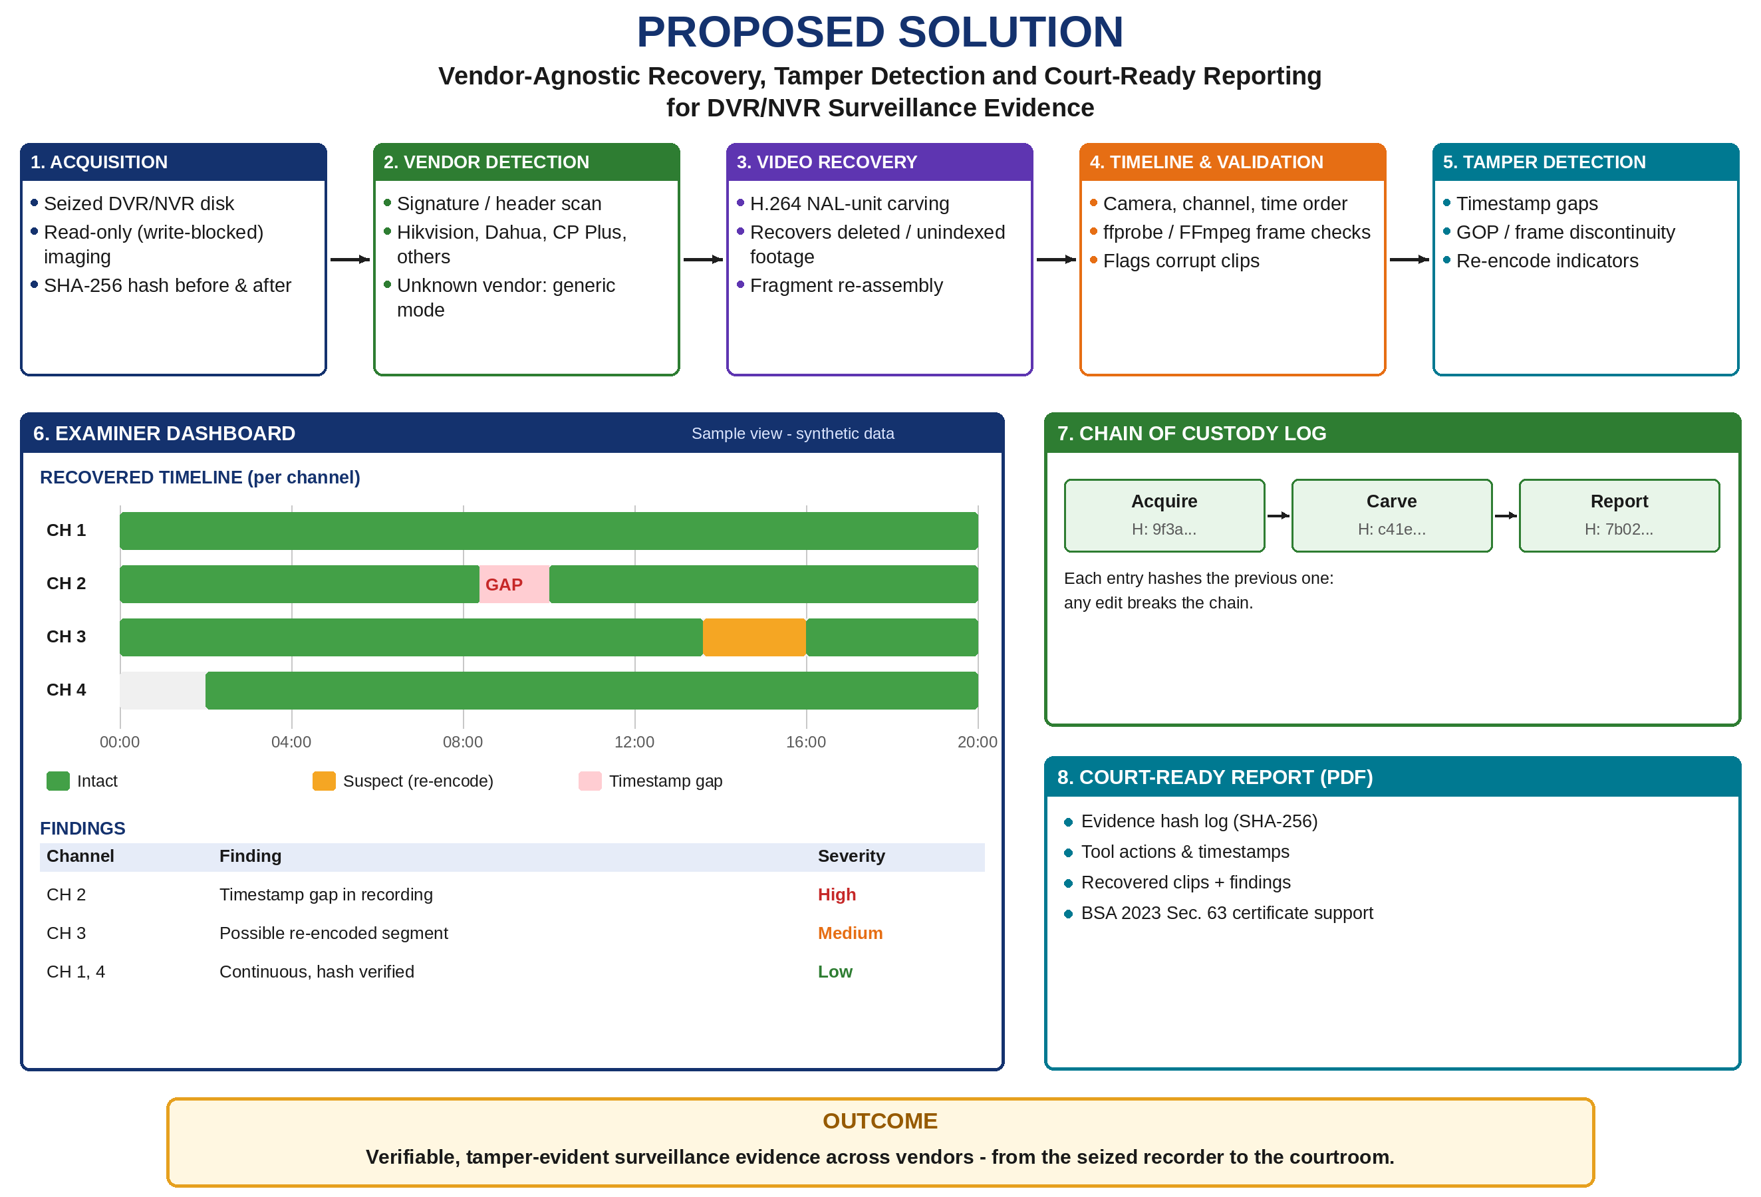
@SIH Idea submission- Template
3

Slide 4
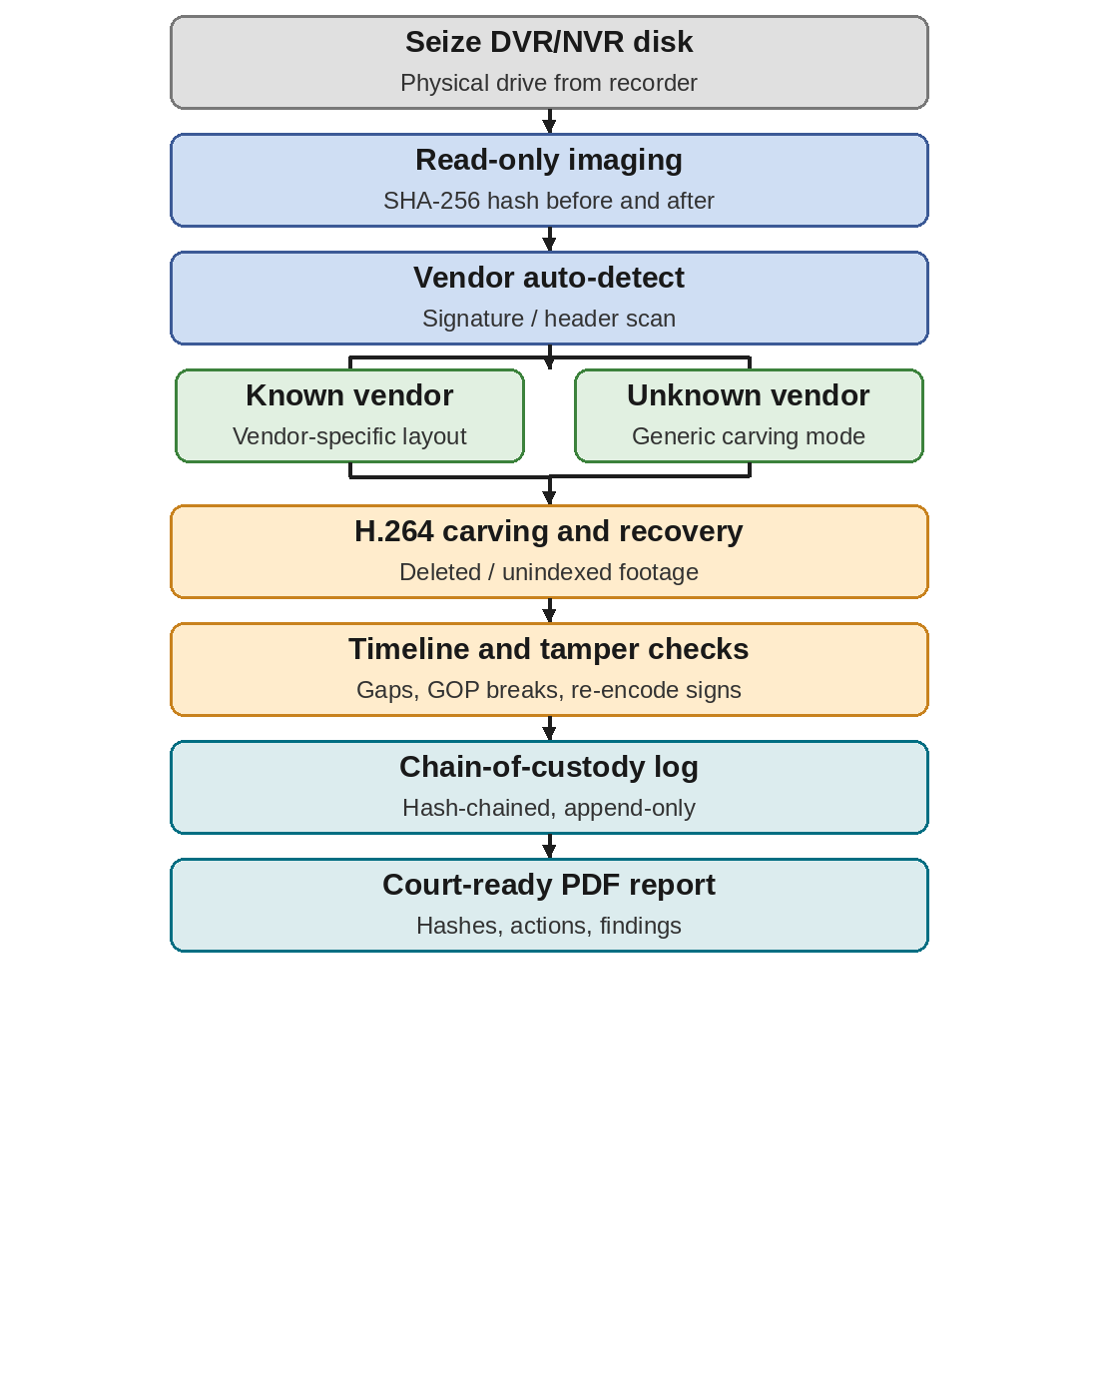
TECHNICAL APPROACH
  Acquisition : Read-only imaging + SHA-256
  Vendor Detection : Header / signature scan
  Video Carving : H.264 NAL-based, vendor-agnostic
  Validation : FFmpeg / ffprobe frame checks
  Tamper Analysis : Timestamp, GOP, re-encode rules
  Custody Log : Hash-chained, append-only
  Backend & UI : Python Flask + React dashboard
  Reports & DB : ReportLab PDF, MySQL
@SIH Idea submission- Template
4

Slide 5
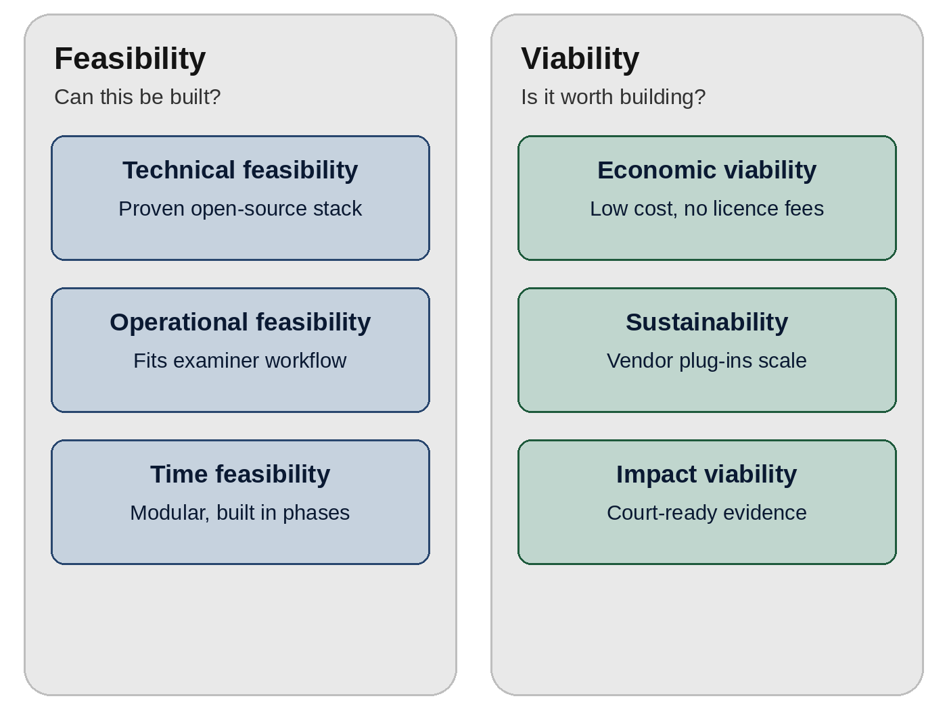
FEASIBILITY AND VIABILITY
Technical Feasibility
  Proven Tools: Python, FFmpeg, ffprobe
  Prior Work: Open-Source DVR Parsers
  Modular: New Vendors Added as Plug-ins.
Operational Feasibility
  Easy Workflow: Acquire to Report
  Human Verification: Examiner Decides
Economic Viability
  Low Cost: Open-Source Technologies
  High Impact: Faster, Court-Ready Evidence
Challenges & Risk Management
  Limited Real Data: Synthetic Disk Images
  Closed Formats: Vendor-Agnostic Carving
  Evidence Integrity: Read-Only Mode + SHA-256
  Legal: BSA 2023 Sec. 63 Certificate Support
@SIH Idea submission- Template
5

Slide 6
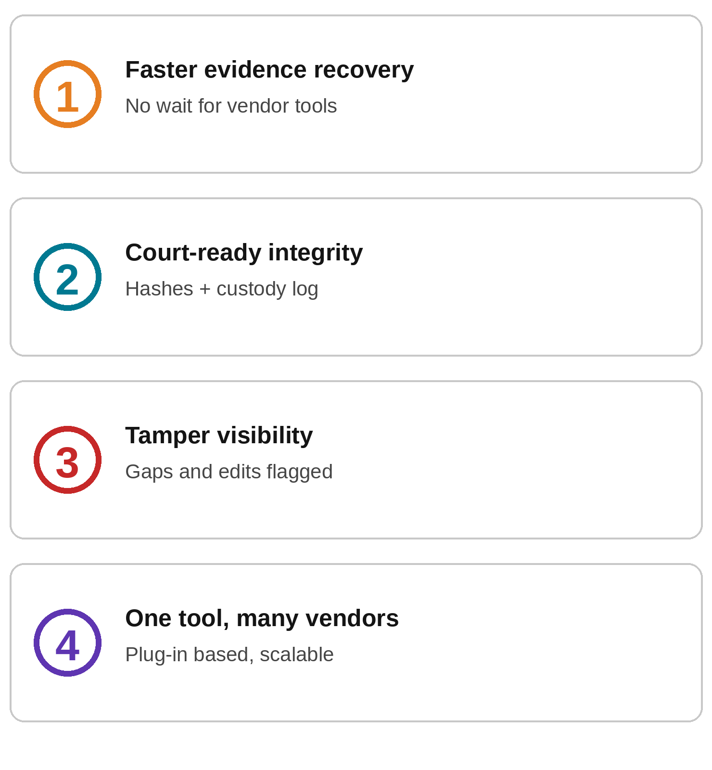
IMPACT AND BENEFITS
  Faster evidence recovery – Recovers footage from proprietary DVR/NVR disks without waiting for vendor tools, so investigators and forensic labs lose less time on seized recorders.
  Court-ready integrity – SHA-256 hashing, a hash-chained custody log and a BSA 2023 Sec. 63 support report help show that the footage was not altered after seizure.
  Tamper visibility – Timestamp gaps, GOP breaks and re-encode signs are flagged, so removed or edited clips are noticed early and can be explained in the report.
  One tool, many vendors – A single vendor-agnostic workflow for police, cyber cells and forensic labs replaces separate vendor tools, and new vendors can be added as plug-ins.
@SIH Idea submission- Template
6

Slide 7

VIDEO LINK
PROBLEM STATEMENT EXPLANATION :
[https://drive.google.com/file/d/1PWS2Dm0cE9cyBf_11i8u3jjqITsyklA-/view?usp=drivesdk]
PROTOTYPE EXPLANATION :
[https://youtu.be/Yz-GFoPBtjE]

Slide 8
RESEARCH AND REFERENCES
1. Smart India Hackathon 2026 — Problem Statement SIH26150 (NTRO), official portal: https://sih.gov.in
2. Bharatiya Sakshya Adhiniyam (BSA) 2023, Section 63 — admissibility of electronic records and the certificate requirement.
3. ITU-T Rec. H.264 / ISO/IEC 14496-10 — NAL unit and SPS/PPS structure used for H.264 stream carving.
4. FFmpeg / ffprobe documentation — frame-level validation of recovered streams: https://ffmpeg.org/documentation.html
@SIH Idea submission- Template
7

Slide 9
THANK YOU
@SIH Idea submission- Template
8

